Slide 1
Binary Sheep
A binary heap gamification project
CSCI3383 Algorithms Final Project 2019
Erin Ballengee, Andrew Lim, and Kamil Piskorz

Slide 2
Our Project
Gamification concept to explore introductory stages of game development while enhancing learning of a core algorithms concept
Graphic design
Underlying logic management
Multiple linked class systems
Binary heaps are an explainable concept that can be made more engaging via gamification, provides an interactive resource for students to learn more about how to execute the swaps to make a maximum (or minimum) binary heap.

Slide 3
The Game

Slide 4
How does it work?
You open the game, and select either the instruction menu or go straight to game play.
Select two sheep to swap at a time in order to make a maximum binary heap.
Try to beat the computer’s score!
Game ends when user creates a correct binary maximum heap, or exceeds maximum allowed actions (O(n - log(n))
Play again!

Slide 5

Java Graphics:
Combining an underlying heap logical structure with visual elements

Slide 6
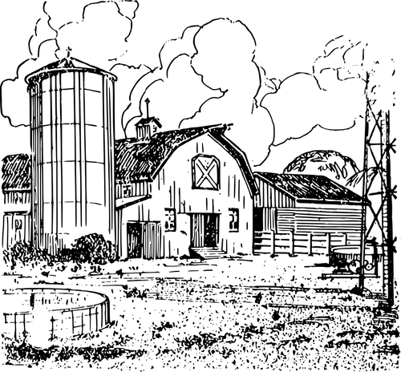
Our Functions/Structure
Heap Functions:
Build, swap
Score tracking based on worst-possible case for swaps O(n-log(n))
Graphics/Audio:
Sound files to play upon certain actions
Logical:
Sheep object that references an underlying array sheepHeap that user manages with swap functions

Slide 7
Challenges We Faced
Java concurrent version management (multiple developers at the same time)
Javascript-HTML-JSON-Java integration
We decided that we would achieve overall better results by just executing the entire project in Java
Multi-File Java Program Challenges
Class management
Cross-program variables and classes
Final program had 9 .java files working with each other

Slide 8
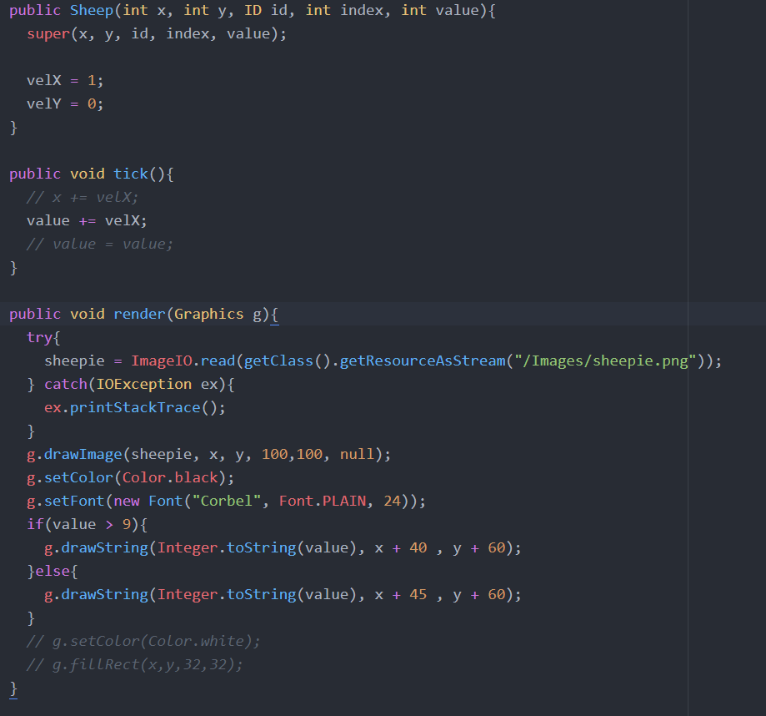
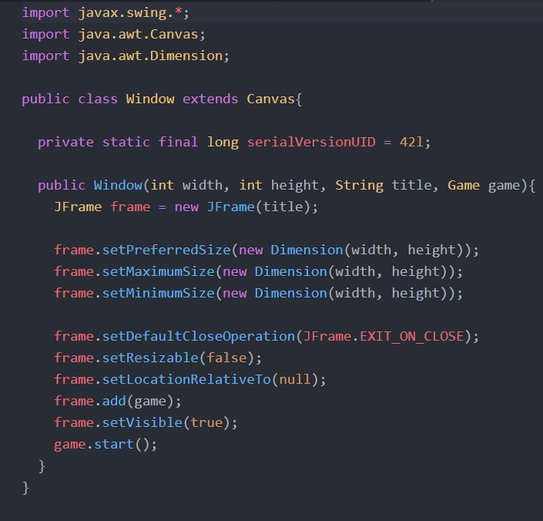
Code Glimpses

Slide 9
DEMO
Live Fire Testing

Slide 10
0
sheep were harmed in the making of this game
(they actually had a lot of fun)

Slide 11
3
CSCI3383 students were harmed in the making of this game

Slide 12

Future Guidance/next steps?
More animation features, dialogue, background music
Dynamic implementation of levels and heap size, max and min heap toggle switch.
Currently, game objects are hard coded into place.
Clicks for swapping, improved visual clarity of selected swap targets as opposed to separate window
Make this game less horridly slow
Heavy, redundant, overlapping code

